Slide 1
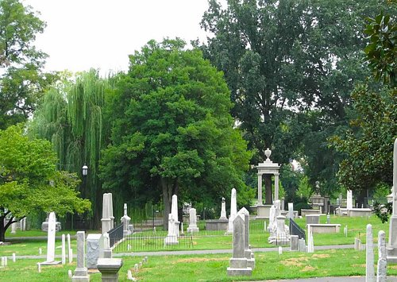


Nashville Historic Cemeteries
ADOPT A PLOT

Slide 2
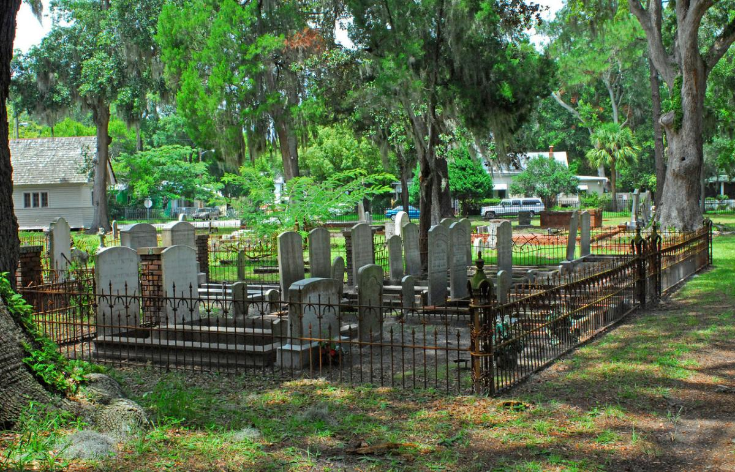
Something for Everyone
Over 19,755 Burial Plots
3,568 Unique Surnames
Discover Cause of Death
Certificate of Adoption

Slide 3
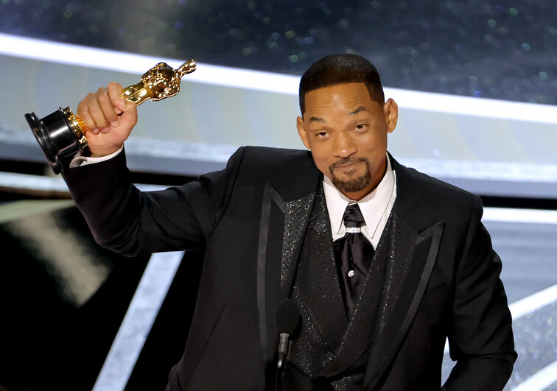
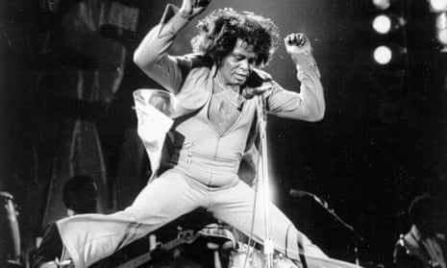
Find your relatives
Notes:
While there are thousands of unique surnames to choose from, Smith and Brown are the most common. But standouts include former president Polk among others.

Slide 4
Interesting Causes of Death
Consumption (Tuberculosis)
Teething?

Slide 5
the Adopt a Plot program, where sadness finds its purpose! turn tears of sorrow into tears of joy by adopting a plot in a historic cemetery near you
November 1, Day of the Dead Festival

